Slide 1
Web Performance: A Journey from Browser to Web server
Joshua Li (d.o: rli)

Slide 2
About myself
Canberra based web architect
Spent most of my time in Gov
Started in Drupal 5.7

Slide 3
Agenda
Define web performance
Why we care about performance
The journey of a web request
How Browser cache works
How Drupal cache works
The simplest architecture

Slide 4
Agenda - cont
A journey of a web request - cont
Why do we need CDN
What role is Varnish playing
Heard of Redis?
Don’t panic and clear the cache?

Slide 5
Agenda - cont
A journey of a web request - cont
The performance oriented architecture - best practice
Wait, what about decoupled Drupal

Slide 6

Define Web performance

Slide 7
Web performance in general
Web performance refers to the speed and responsiveness of a website. It encompasses two aspects:
Objective measurements: This includes things like how long it takes a page to load, how long it takes for elements to become interactive, and how smooth the overall experience is. These are measured using various tools and metrics.
Perceived user experience: This is how fast the website feels to users. Even if a website has good objective measurements, it can still feel slow if it doesn't load content in a user-friendly way.
– Google Gemini

Slide 8

Web performance matters
Poor web performance
Bad user experience
1 in 4 visitors would leave a site that takes more than 4 seconds to load
Every 1 second delay reduces user satisfaction by 16%

Slide 9

A journey of a web request

Slide 10


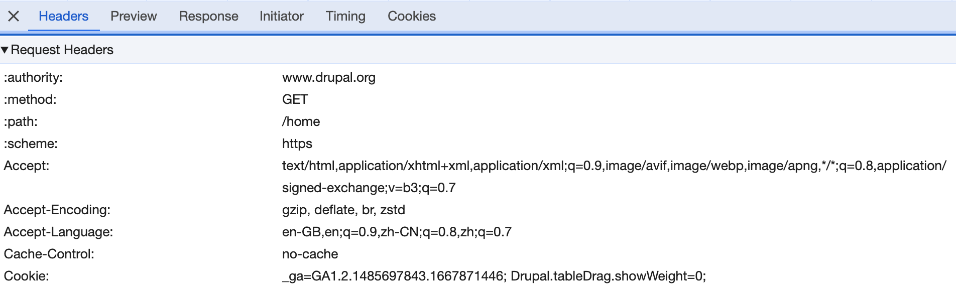
The Journey started with a click…

Slide 11
Browser level caching
Cache happening
ETag:
The ETag (or entity tag) HTTP response header is an identifier for a specific version of a resource. It lets caches be more efficient and save bandwidth, as a web server does not need to resend a full response if the content was not changed. Additionally, etags help to prevent simultaneous updates of a resource from overwriting each other.
Note: the last updated time will be baked in the ETag hash
Browser
Check if to load a cached version

Slide 12

Browser level caching
Render cached response
Cached version exist?
Yes
Cache-control: no cache
Cache-control: Max-age
No
Yes
No, keep sending
Yes
If the current time is beyond max cached time (if-modified-since)
304
Send request with previous ETag (if-none-match)
Render new response
HTTP 304 or 200?
200
Response with ETag
Target

Slide 13

The request’s journey
Request
DNS service
Your Web Server

Slide 14
The request’s journey
Drupal
PHP
Database
Your Web Server
Nginx
Cache tables
Content tables
Your Web Server

Slide 15
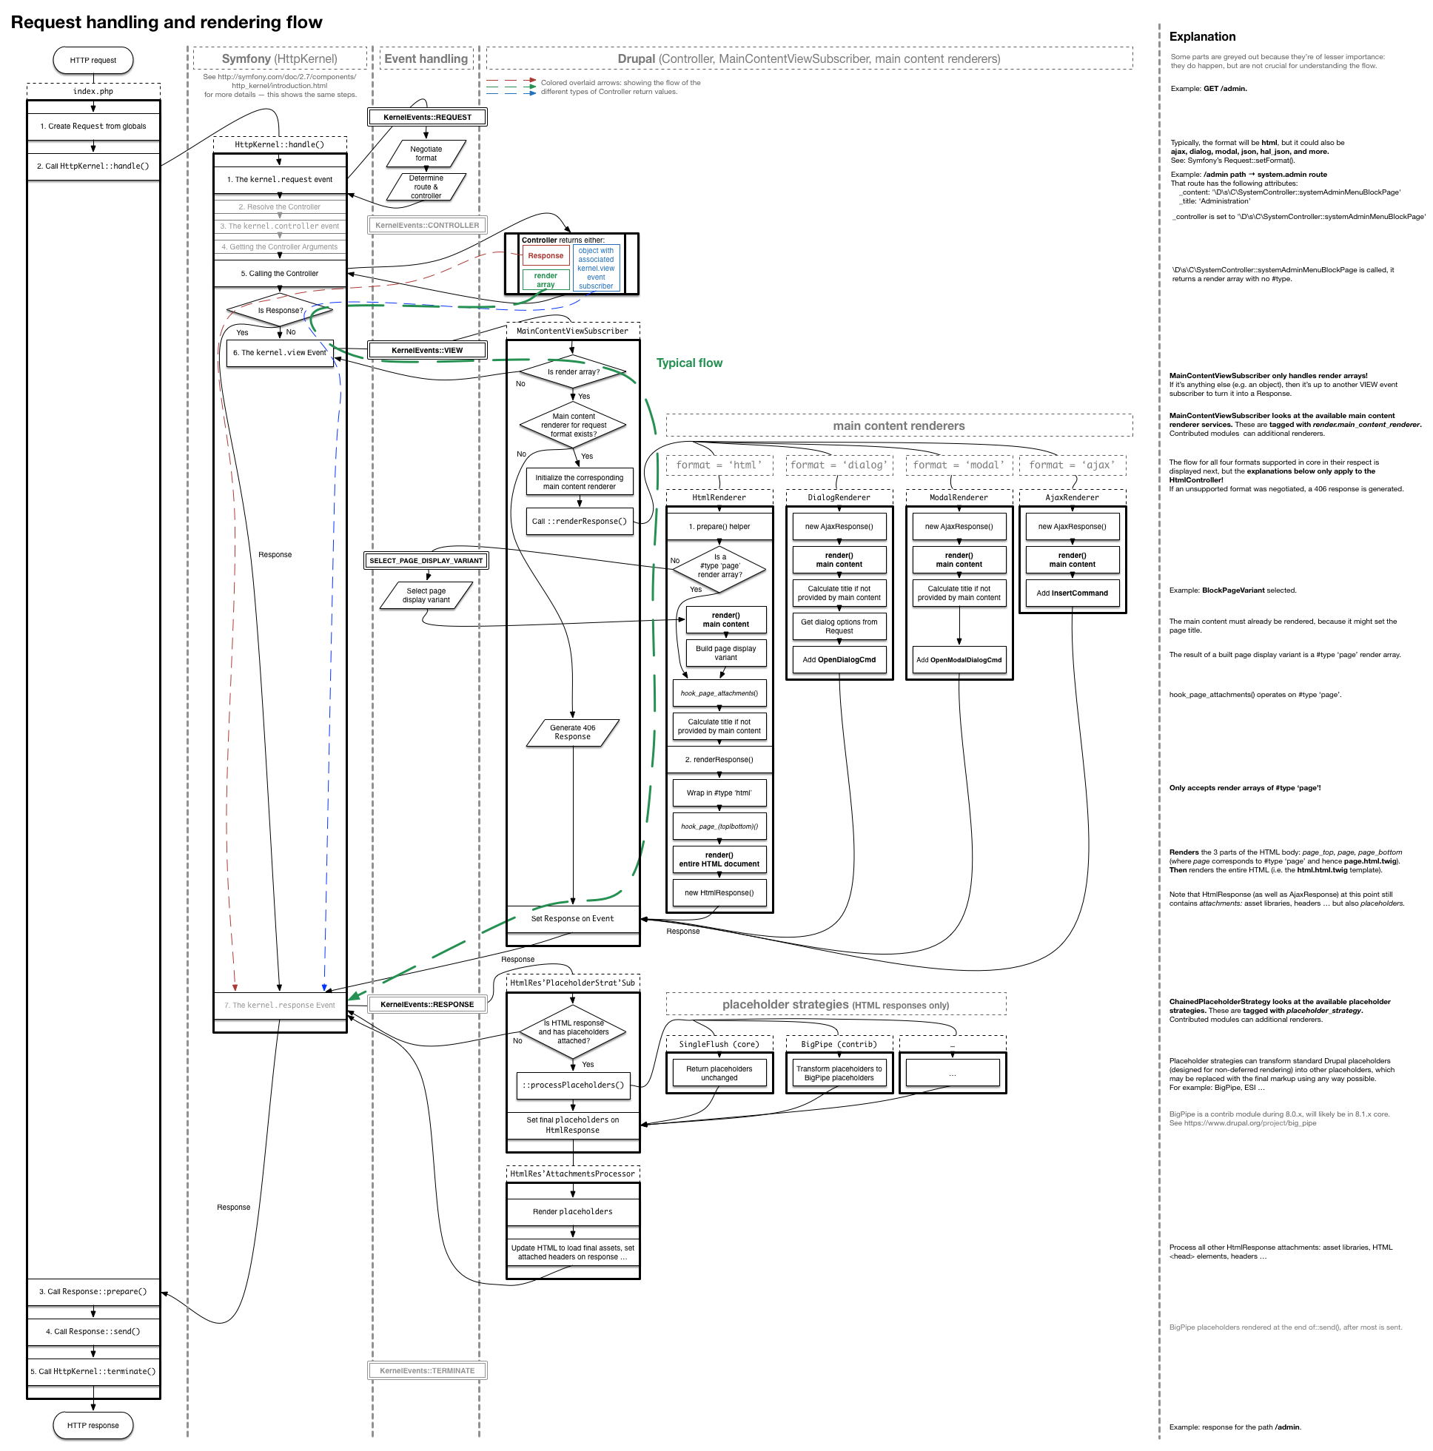

Drupal render flow - By default

Slide 16

The simplest Drupal architecture
Cache happening
Cache happening
Browser
Web
server
Database
Browser
Web
server
Database
Browser
Web
server
Database
Browser
Web
server
Database
Browser
Web
server
Database

Slide 17
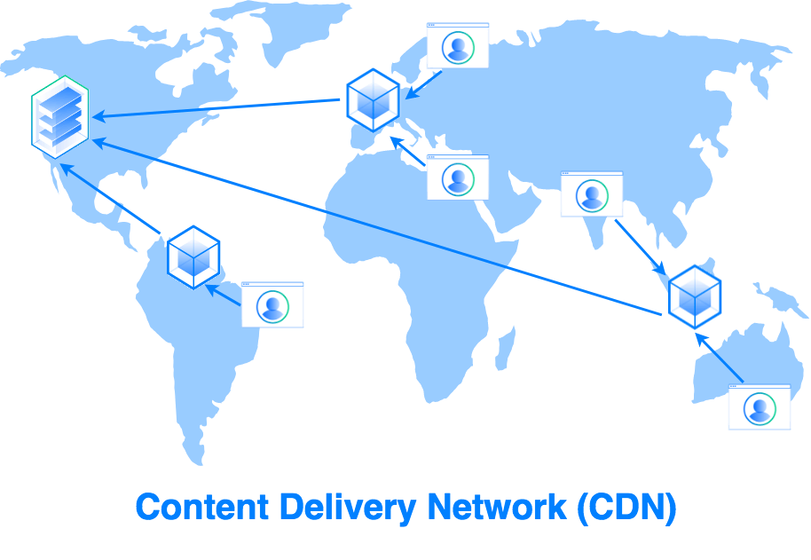
CDN - Content distribution Network

Slide 18
CDN - Content distribution Network
CDN
Cache happening
Cache happening
Cache happening
Browser
Web
server
Database
95% traffic
5% traffic
Managed service

Slide 19
CDN - Content distribution Network
Less traffic to the web server
Firewall - DDoS management
Custom rules to pass or redirect particular request
Distinguished treatment according to tags, cookie, etc
File storage

Slide 20
Varnish - Web server level caching
Less traffic to Nginx server
Cached response found
Nginx
Upstream
Varnish
HTTP response cached by URL
No cached version found against URL
Request
VCL configuration

Slide 21
Varnish - Web Server level caching
CDN
Cache happening
Cache happening
Cache happening
Cache happening
Browser
Varnish
Nginx
Database
95% traffic
5% traffic
90% traffic
Web server
Managed service

Slide 22
Redis - cache tables in memory
Less traffic to DB server
Cached results found
Drupal in Nginx
Database
Redis
No cached result found against request
Request
Redis in-memory Database

Slide 23
Previously …
Drupal
PHP
Database
Your Web Server
Nginx
Cache tables
Redis NoSQL
Content tables
Your Web Server

Slide 24
Best practice
CDN
Cache happening
Cache happening
Cache happening
Cache happening
Browser
Varnish
Nginx
Database
95% traffic
5% traffic
90% traffic
Cache happening
Web server
Managed service
redis

Slide 25


Don’t panic and clear the cache? Drush CR

Slide 26
When the cache is cleared, in prod
CDN
Browser
Varnish
Nginx
Database
Browser
Browser
Browser
Browser
Millions of different requests
Browser
Web server
Managed service
redis

Slide 27
Cache tag: clear cache as needed
Drupal cache tag - https://www.drupal.org/docs/drupal-apis/cache-api/cache-tags
Drupal caches entities forever by default
Add tags (dependencies) to render array
Bubbled up tags to URL
Enables selective cache clear

Slide 28
Bubbled up Cache tags
Tags applied to the render entity
Node:1 - Current page cache will be cleared when node 1 is updated
Node_list:article - Current page cache will be cleared when the article list is updated
<entity type ID:entity ID> - Current page cache will be cleared when entity X is updated

Slide 29
Bubbled up Cache tags
Https://Drupal-cache.com/node/4
HTTP response includes:
Cache tag: node:4, node:5, all the article nodes, user:2)
Any above entity changes, this page cache get cleared.
Be careful: there is a limited on the header size. Can't put too many values to it.
Https://Drupal-cache.com/node/4
Tags applied to the render entity
Node:1 - Current page cache will be cleared when node 1 is updated
Node_list:article - Current page cache will be cleared when the article list is updated
<entity type ID:entity ID> - Current page cache will be cleared when entity X is updated
Referenced Feature news (node:5)
User information
(user:2)
Related news (node 1)
Related news (node 2)
Related news (node 3)
News article view

Slide 30
The purge module- Integrated with Varnish and CDN
CDN
Still cached!
Cache clearing
Cache clearing
Cache clearing
Browser
Varnish
Drupal
Nginx
Database
Cache clearing
Web server
Managed service
redis

Slide 31
Debugging
Drupal automatic clearing the cache for you, IF YOU USE THE CACHE TAGS
And that also works in Redis, Varnish, and CDN if we use the purge module to integrate with them
Check the response header (Pragma headers for Akamai) - clear browser cache
Remember query strings are treated differently

Slide 32
Tips
Try to use Drupal to render as much as possible
Developers: always code with the cache in mind
Use frontend solution (JS API calls) when
A global value is constantly changing
Integrating with the third party API
Personalisation

Slide 33
Challenge: for a site with millions of different URLs
When you have same controller serving Millions of different arguments
location/{country-name}/{region-name}/{district-name}/{suburb-name}/{lat, long}/details
CDN and Varnish will pass because the URLs are different, Redis will hit to return the same entities
Think about Frontend solution - Drupal single node provide the markup, JS to fetch the details from an endpoint - makes user thinks the site is working

Slide 34
Is decoupled Drupal better in performance?
The initial response sizes may be similar or larger
The response size is smaller when pulling new data / new page
Entire cache needs to be cleared after a layout change
Be careful of the CPU usage from Browser - crazy state management

Slide 35
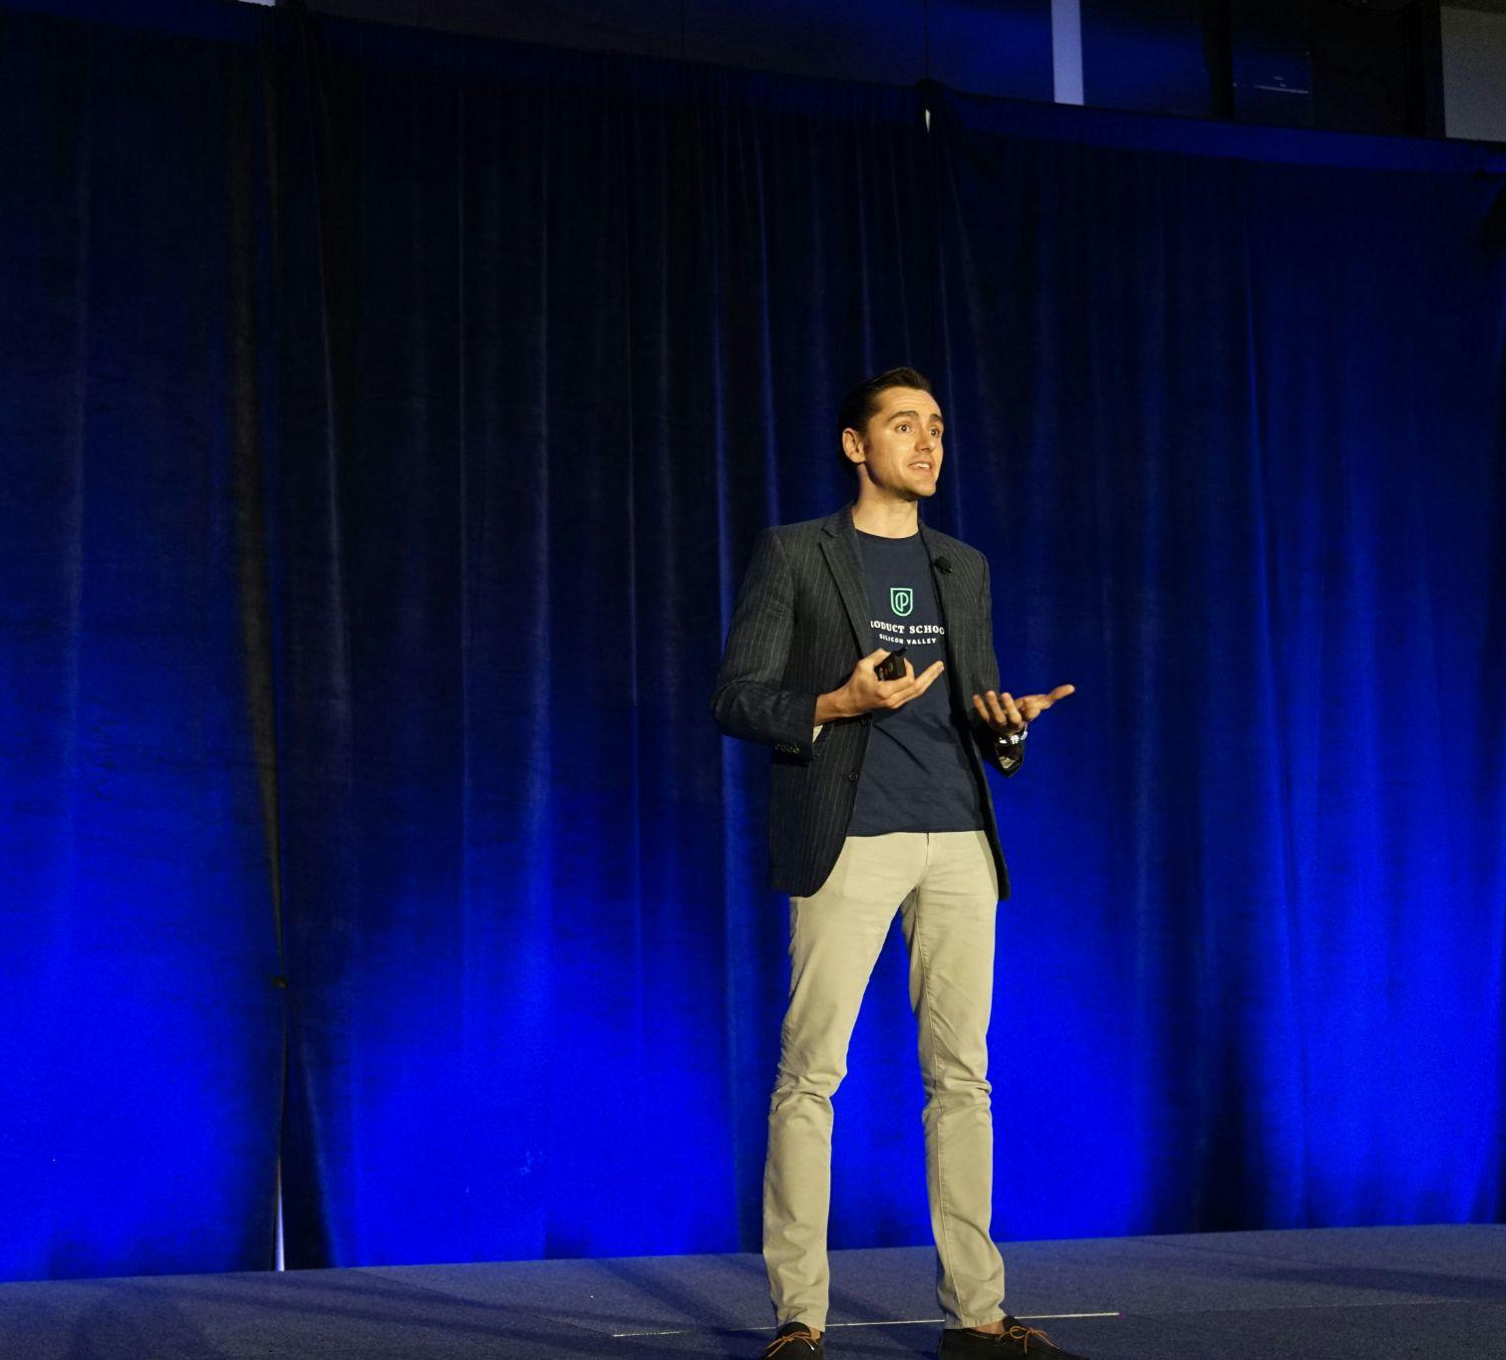
Some missing topics
Drupal Cache context
Clear cache with CID - custom logic
The powerful CDN
Decoupled server-side rendering
Surely there are more …

Slide 36


Reference
https://www.drupal.org/docs/8/api/render-api/the-drupal-8-render-pipeline
https://www.drupal.org/docs/drupal-apis/cache-api/cache-tags

Slide 37

Questions?

